Slide 1

A Presentation on CLUB MANAGEMENT SYSTEM
Presented By
Khandaker Tasfia Reza (19202103286)
Tanbir Hasan Bhuiyan (19202103294)
Md Mahabub Morshed (19202103298)
Munzirul Alom (19202103303)
D.M Ajmain Shaharir (19202103308)
Supervised by
Ms Sadah Anjum Shanto
Lecturer of
Dept. of CSE (BUBT)

Slide 2
Outline of This Presentation
Introduction
Objectives
Motivation
Features
Audience
UML Diagrams
Implementation
Limitations
Future Works
Conclusion

Slide 3
1
Introduction

Slide 4
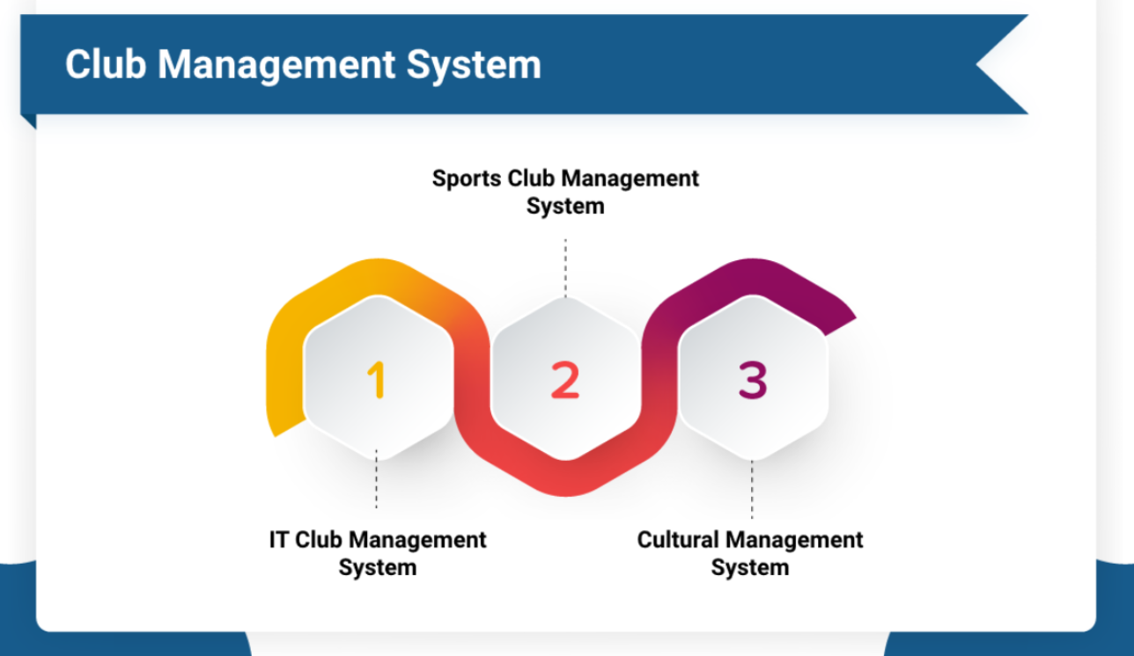
Introduction
Club Management System (CMS) ?
Record keeping
Maintenance.
Is CMS important?
To control everything at one place.
Benefits of using this CMS?
Clubs, users and events easy management.

Slide 5
The notable problems with the manual club management system
1. Manual Data record-keeping
2. Users can’t see the events al-together
3. Security
4. No accessibility to all clubs

Slide 6
2
Objectives

Slide 7
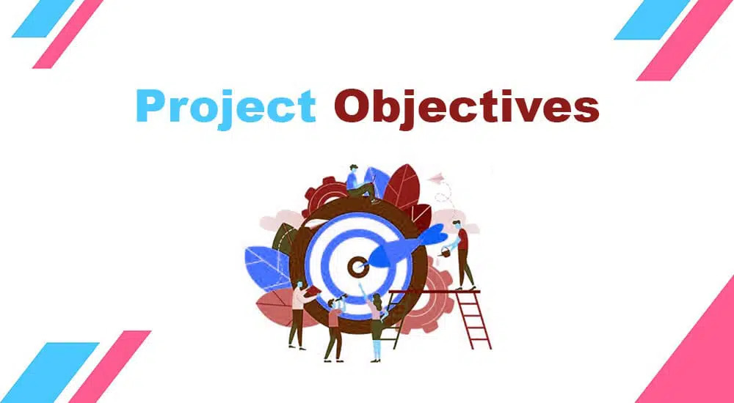
Objectives
Well developed system
Framework less raw coded application
Interactive dashboard
Efficient web application
Passing control
work and events easy management
Open source project

Slide 8
3
Motivation

Slide 9
Motivation
Reasons behind choosing this system
Lack of available management system
No well-organized club
No free club management services
e

Slide 10
4
Features

Slide 11
System Features
Multiple Admin
User Own Profile
Event creation
Notifications
Club-wise Accessibility
Password Recovery
Member Chatting
Club Creations
Level Wise Accessibility

Slide 12
5
Audiences

Slide 13
Audiences
Separate admin for every club
Single president and vice-president
Executive member controls event
General members are volunteer

Slide 14
6
UML Diagrams

Slide 15
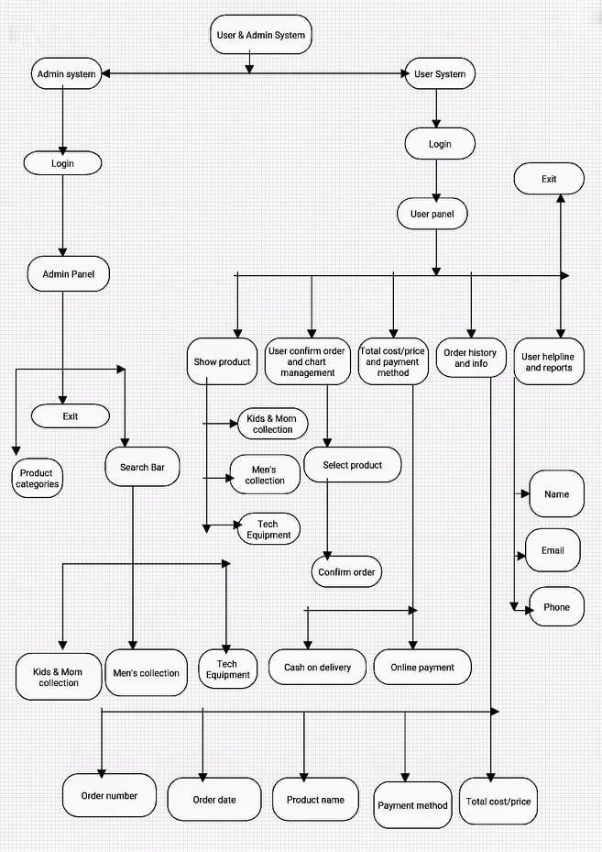
INFRASTRUCTURE OF OUR MANAGEMENT SYSTEM

Slide 16
7
Implementations

Slide 17
System Requirements
HARDWARE ( Minimum Requirements )
Minimum RAM: - 2GB or more
Hard Disk: - 32 GB or more
Processor: - Intel Pentium 3 or above
SOFTWARE ( Minimum Requirements )
Operating system: Windows XP,7 or any latest OS.
Wamp server
MySQL, PHP
GitHub and Latex (ONLINE tools).
Analyzing Software: Sublime Text

Slide 18
8
limitations

Slide 19

Limitations
Unusual but little limitations
No paid event participation
Notifications
Notifications via Email
Chatting with other members

Slide 20
Related work and their infrastructure
Email and Web notification System
Payment gateway integration
Club-wise task management system
Communication System

Slide 21
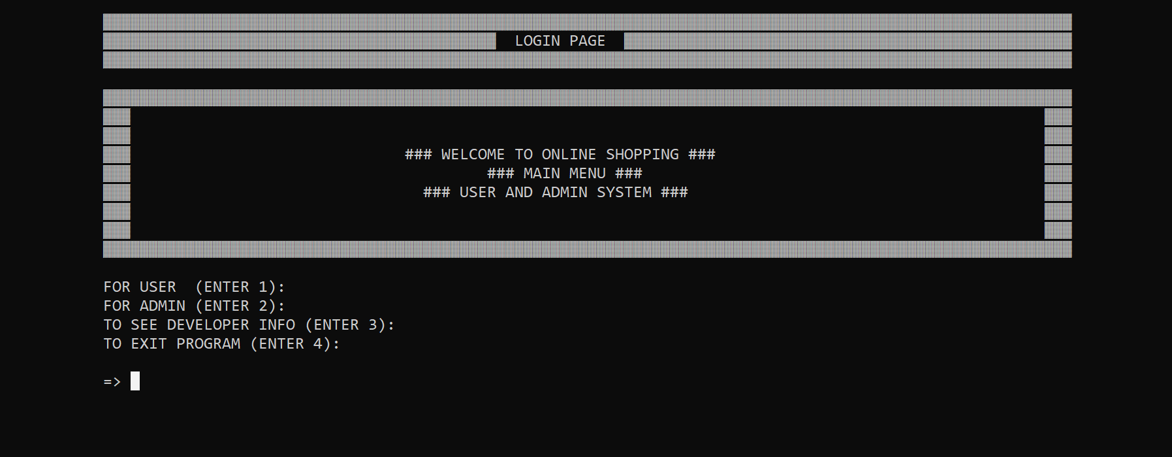
Login Page

Slide 22
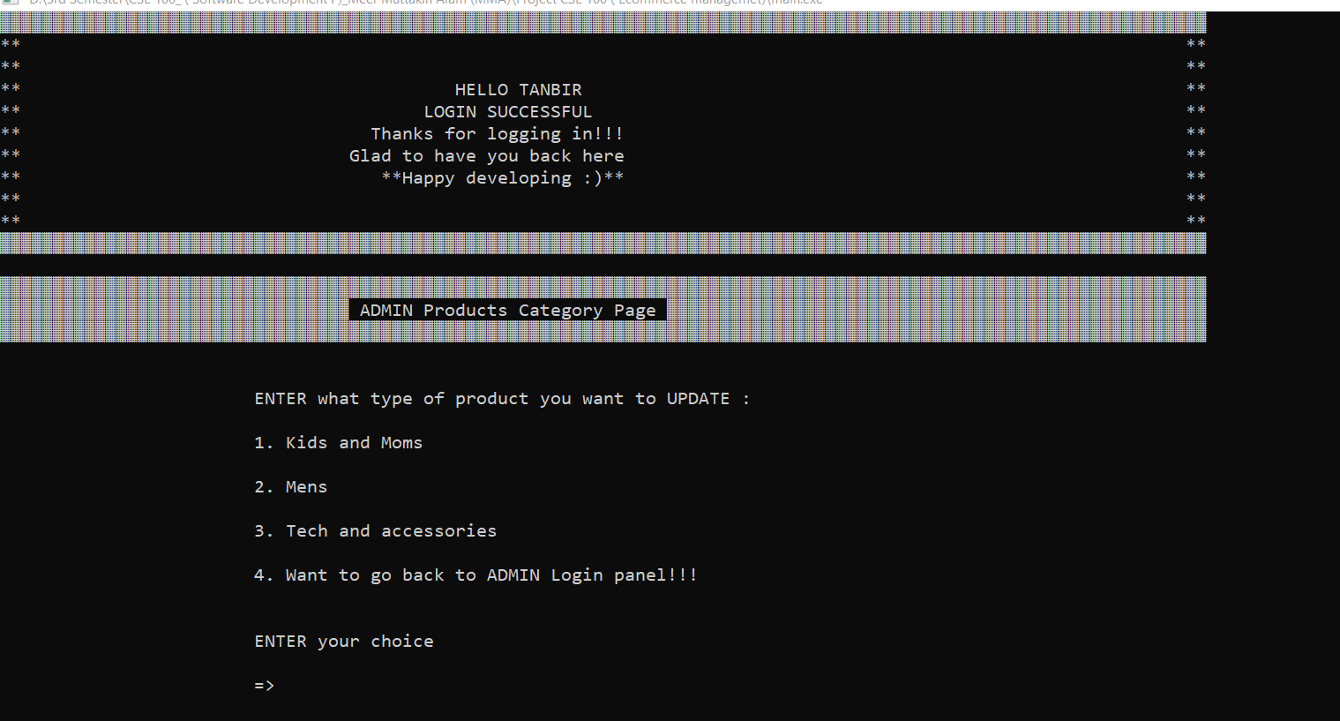
Admin Login Successful & Developer Category Section

Slide 23
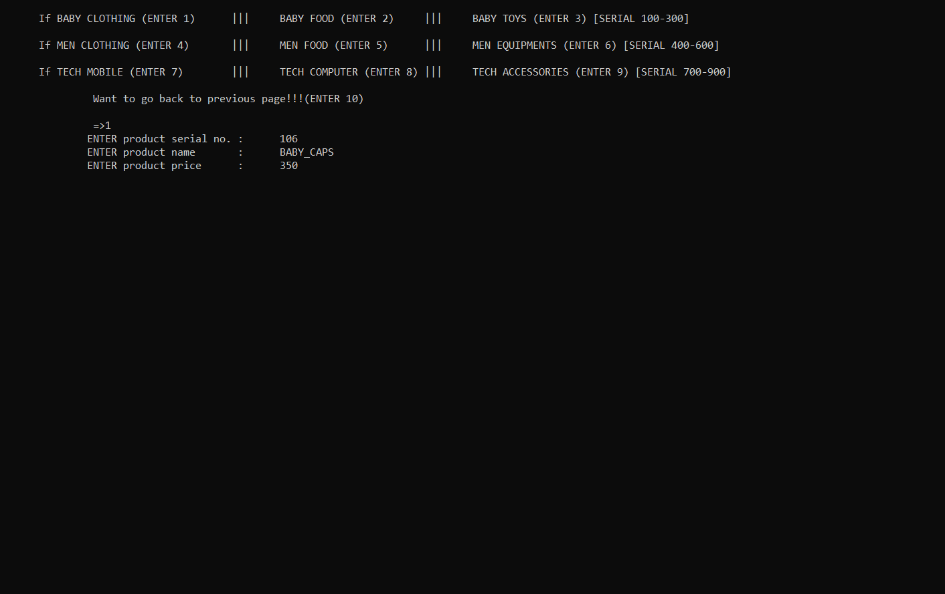
Add & Delete Products by Admin from Any Category

Slide 24
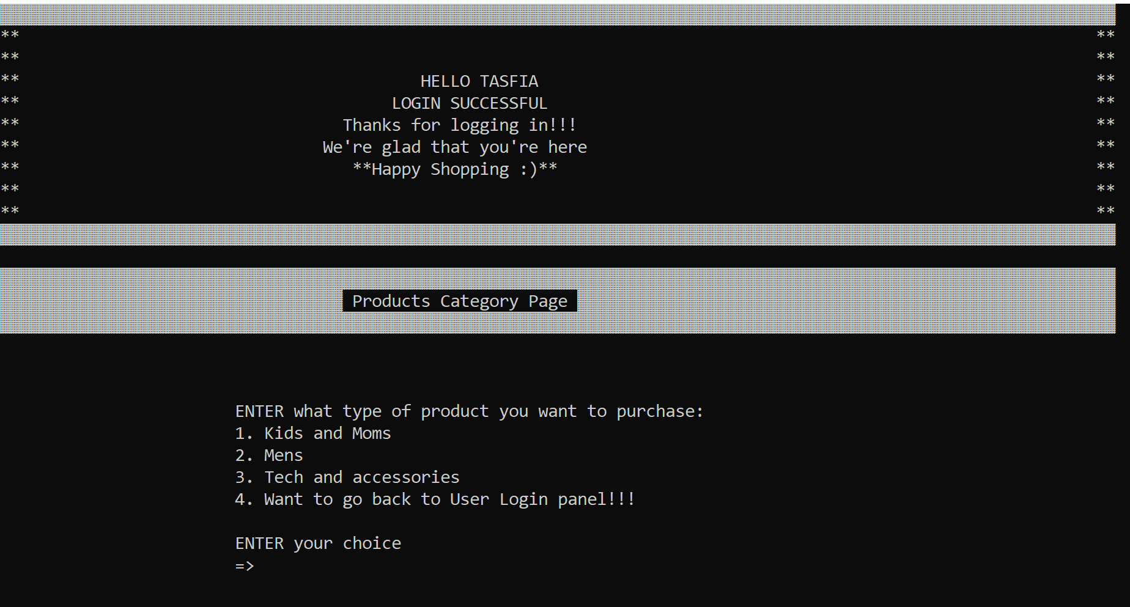
Successful User Login & Product Categories

Slide 25
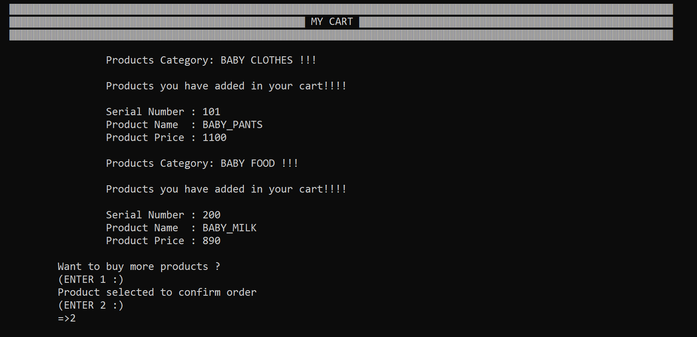
Baby Food and Clothes Selected to Order in the Cart

Slide 26
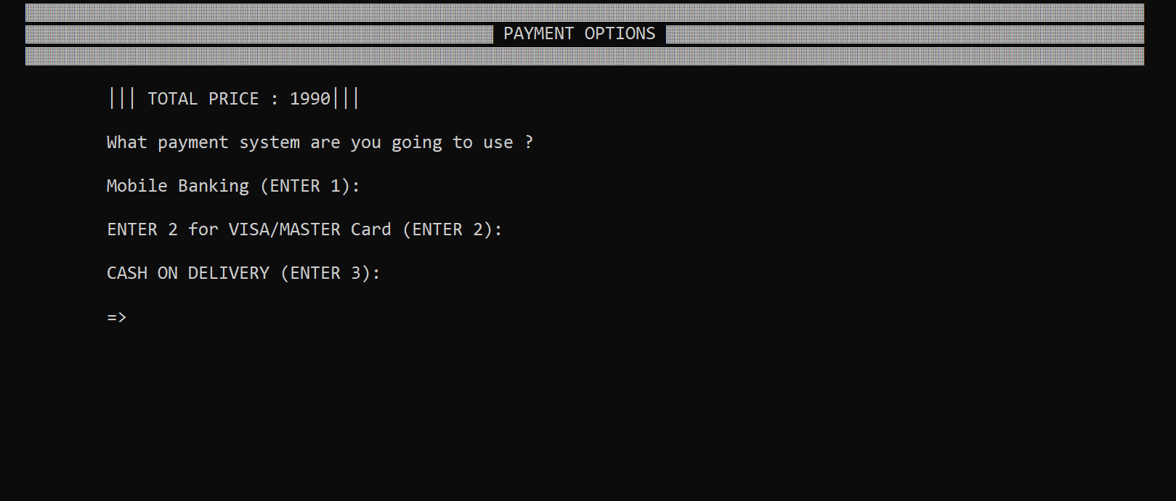
Payment Section to Select Payment Methods

Slide 27
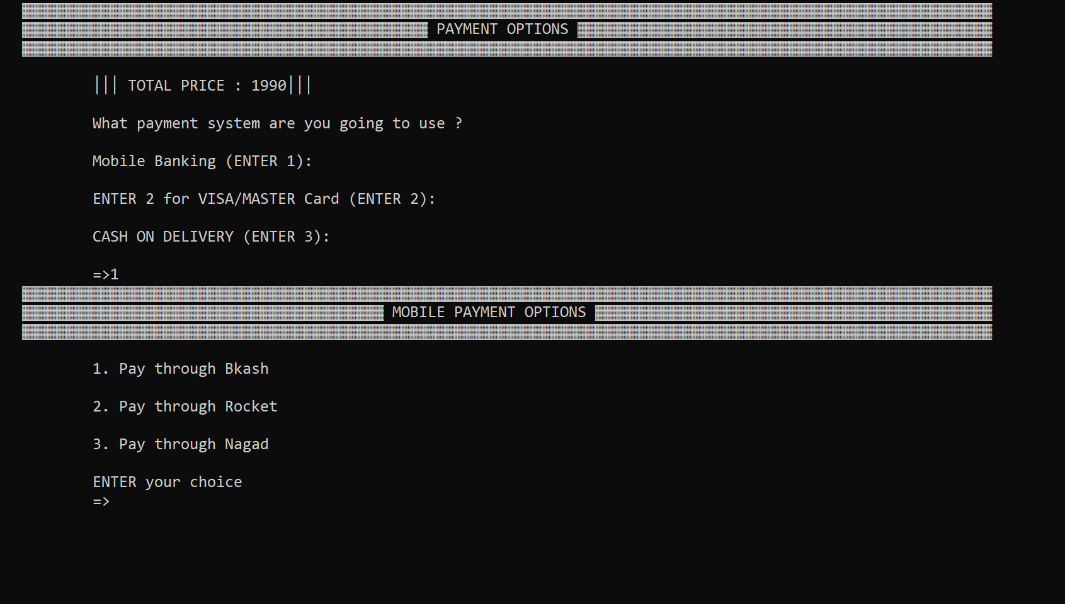
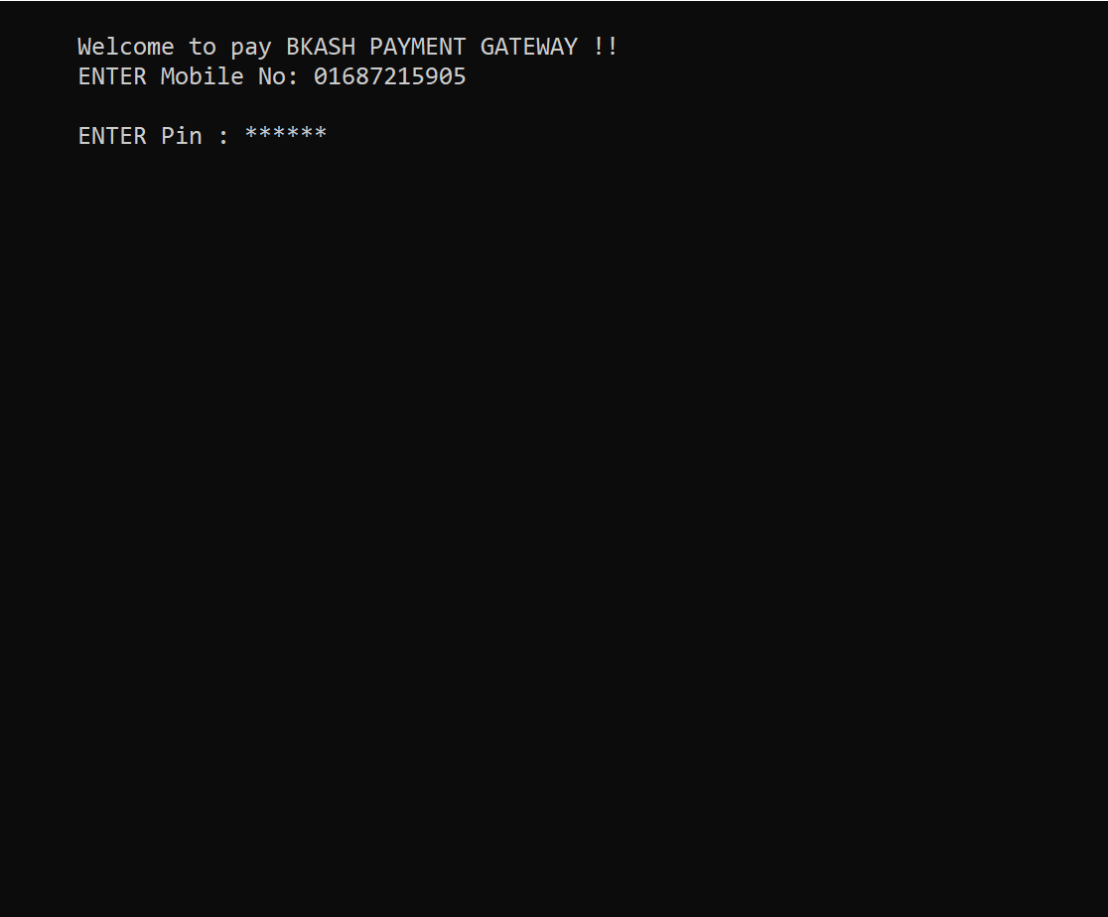
Mobile Payment Option and Payment Gateway

Slide 28
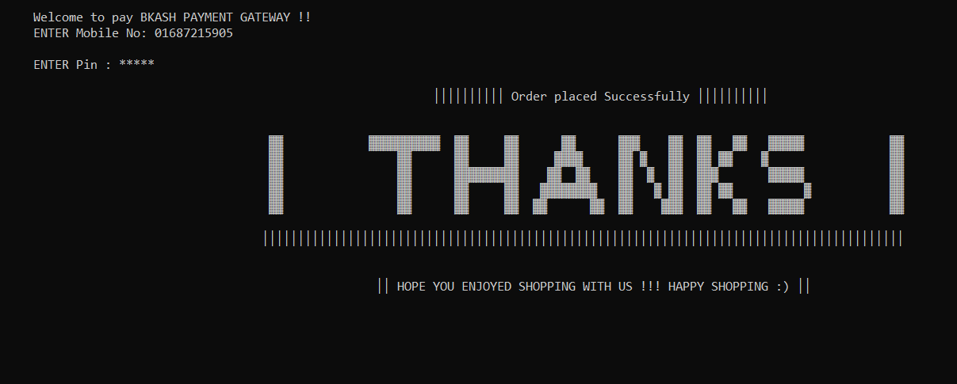
Order Placement Successful

Slide 29
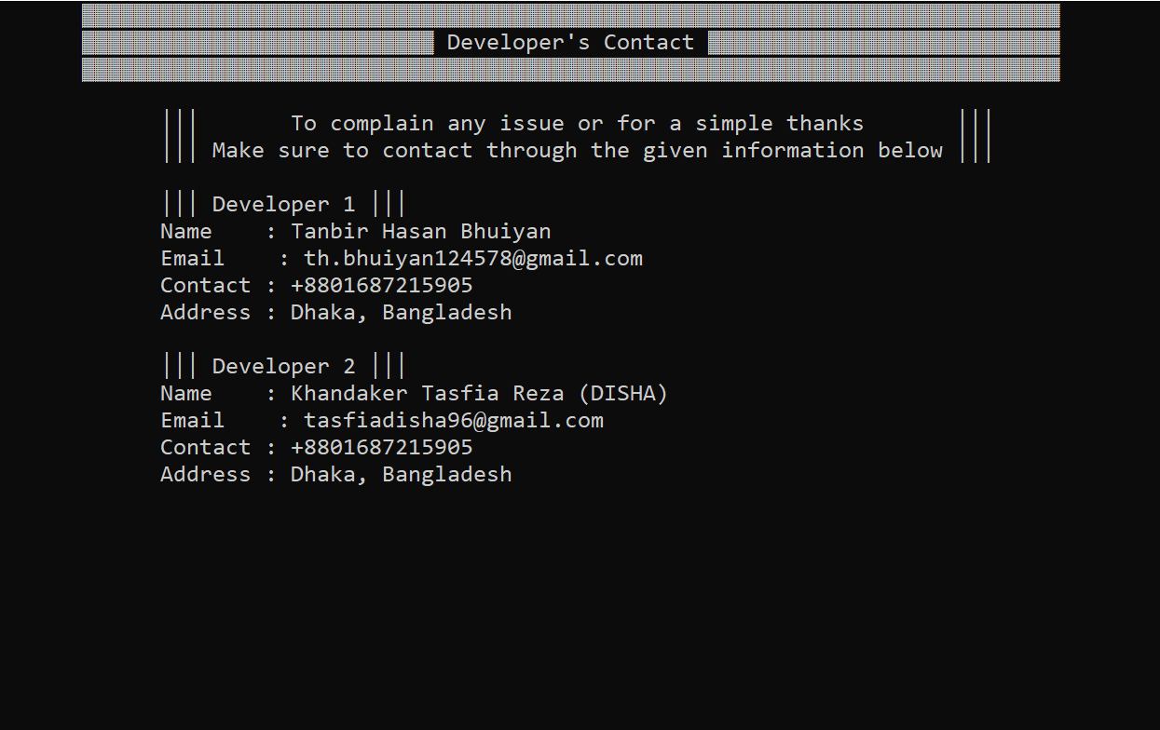
Developer Contacts

Slide 30
9
Future Works

Slide 31
Future works
Implement email and web notification system.
Improve design and functionality
Payment gateway integration.
Club wise events management system.
Add club member communication system.
Including these system improvements, we have plan to make it more oriented for management as well.

Slide 32
10
conclusion

Slide 33
Conclusion

Slide 34
Thank you all
for your patience.

Slide 35
Any Questions
?

